Slide 1


WRES Action Plan 2024

Slide 2
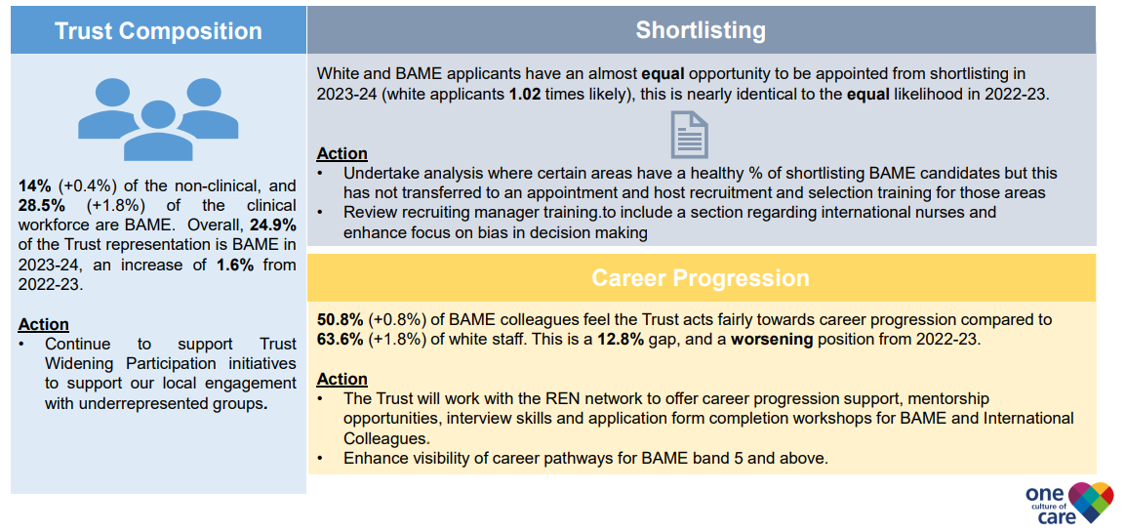
WRES Action Plan (1)

Slide 3
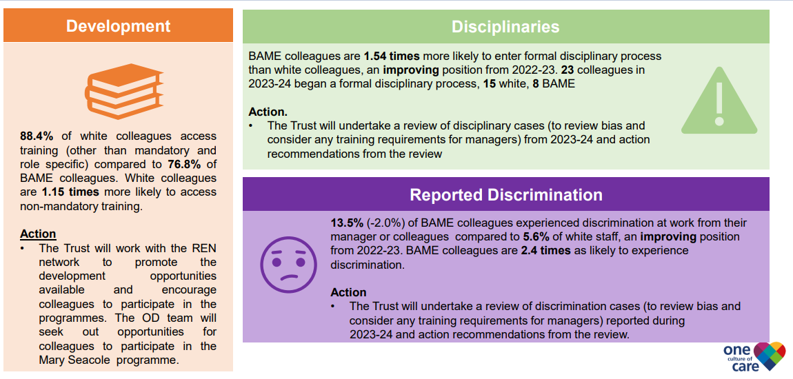
WRES Action Plan (2)

Slide 4
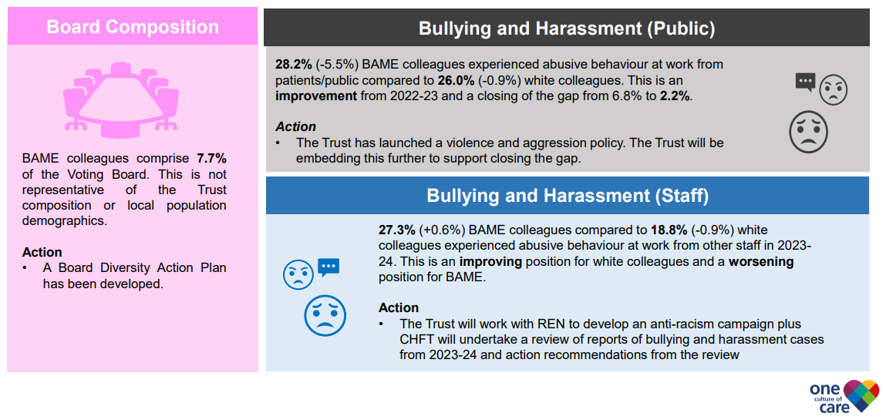
WRES Action Plan (3)

