Slide 1

Whiplash and Neck Pain

Slide 2
Whiplash
Whiplash is a common injury caused by a sudden jerking movement of the head forwards and backwards or side to side. This force causes soft tissue around the spine to be stretched and pulled, which often results in pain and stiffness within the muscles.

Slide 3
What causes whiplash?
The most common causes of whiplash are:
Traffic collisions
Blows to the head e.g. during contact sports
Slips/falls which result in a sudden jerking movement of the head and neck.

Slide 4
Symptoms of whiplash
Pain and stiffness around the neck
The neck muscles may feel tender to touch
Loss of range of movement in neck.
Pain moving the shoulders and arms
Headaches
Disturbed sleep
It is not as common but some people experience pins and needles and or numbness in the arms

Slide 5
Symptoms of whiplash can sometimes take 24 hours to develop and can worsen over a couple of days.
Whiplash is usually diagnosed through the description of symptoms and mechanism of injury.
Further investigations such as x-rays and MRI scans are not usually carried out unless more serious spinal injury is suspected.

Slide 6
Whiplash recovery
The time it takes to recover from a whiplash injury can vary greatly.
Most people will feel better within a couple of weeks/ months, but in some cases symptoms can last for up to a year.
It is important to try and maintain movement of the neck following a whiplash injury to prevent increased stiffness and pain.
Avoid resting for long periods of time, as early movement will improve and speed up recovery.
Pain and stiffness on movement is normal and will not cause damage.

Slide 7
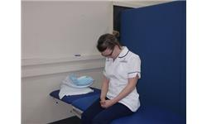
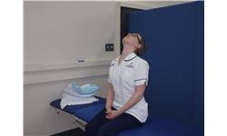
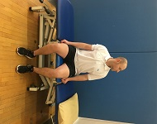
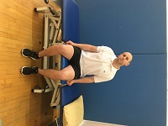
Look down, taking your chin towards your chest.
You will feel a stretch.
Look up, taking your chin towards the ceiling chest.
You will feel a stretch.
Look left/ right.
Tilt your head / right, taking your ear down towards your shoulder.
Keep your shoulder relaxed.

Slide 8
Management of symptoms
Painkillers
Please seek the advice of a Pharmacist/GP regarding the use of simple pain relief medication. This will help to reduce pain and allow you to keep active.
As an alternative you can rub anti-inflammatory creams over tender areas.
These should be used regularly instead of just when the pain is at its worst.
It is important that you follow the advice of your GP to check that medication is suitable for you to take.

Slide 9
Heat and Ice
The use of heat can help with pain and muscle relaxation. Use a warm water bottle, or microwavable wheat bag, following the instructions provided when you purchased it. To protect your skin from heat burns, wrap the item in a few layers of towel. Leave in place for 15-20 minutes. It can be reapplied after 2 hours if you wish.
The use of ice can help with pain and inflammation. Use crushed ice cubes or a bag of frozen peas. To reduce the risk of developing an ice burn place the ice pack in a wet towel. Leave in place for 15-20 minutes. It can be reapplied after 2 hours if you wish.
It’s normal for the skin to become pink with either heat or ice, however if you experience discomfort or a burning sensation remove the item immediately. Don’t apply heat or ice packs if you have poor skin sensation or poor circulation, if you are diabetic or over areas of infection.

Slide 10
Physiotherapy
The aim of physiotherapy is to aid in restoring normal movement and function to the body.
A physiotherapist will assess your movement and pain and provide you with appropriate exercises to be completed daily.

Slide 11
Long term whiplash
If symptoms persist for over six months whiplash injury is classed as long term or chronic/persistent.
Continued physiotherapeutic exercise and use of adequate pain relief is advised.
If you find you are struggling to cope with your symptoms speak to your GP regarding other support that is available.

Slide 12
Resources
Our website – leaflet, exercises
https://www.arthritisresearchuk.org/arthritis-information/conditions/neck-pain/neck-pain-exercises.aspx
https://www.nhs.uk/conditions/whiplash/
https://www.nhs.uk/conditions/neck-pain-and-stiff-neck/
http://www.csp.org.uk/publications/neck-pain-exercises

