Slide 1
Equality, Diversity and Inclusion
5 Year plan to December 2024

Slide 2
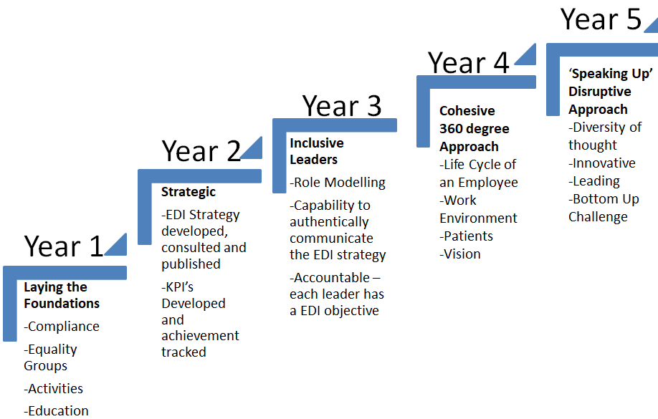
Plan on a page

Slide 3
Year 1 – Laying the foundations
Activities | Metrics
-Equality Groups have a say in the way we shape our direction of travel Our intent is to empower employees to make a difference, input into policies, equality impact assessments, sharing their lived experiences -Unconscious Bias ‘Stand in Their Shoes’ Programme - to be incorporated into management essentials and inclusive leadership programme. This programme will be mandatory for ‘key decision makers’ to attend -Inclusion Roadshows – spreading awareness of difference ‘on site’ / bite size learning sessions for front line colleagues | Growth in membership and impact 70% of key decision makers attending this programme by December 2020 Will visit 50% of the CHFT footprint by December 2020

Slide 4
Year 2 – Strategic
Activities | Metrics
-Provide development opportunities for our middle managers, including the ‘Empower’ programme, peer-to peer coaching /BAME mentoring -Inclusive Recruitment -Review our workforce policies/procedures, providing briefings on any changes to line managers ie transgender guidance -Responsible Procurement– All partners / contractors should have an Equality and Inclusion Policy. | E,D&I Dashboard developed and analysis undertaken to understand ‘hot spots’ I.e.. Disability confident stage 2 100% of policies reviewed by an inclusion representative Clear and consistent E,D&I requirements embedded in our procurement contracts

Slide 5
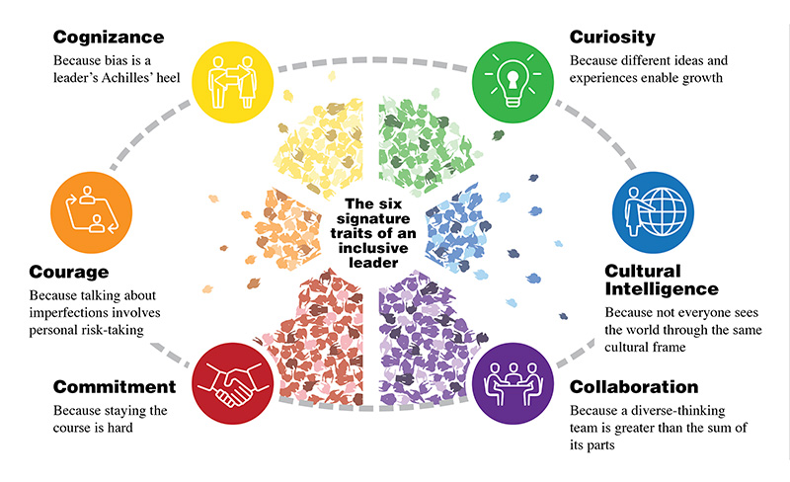
Year 3 – Inclusive leaders
Grow authentic inclusive leaders who walk the talk every day

Slide 6
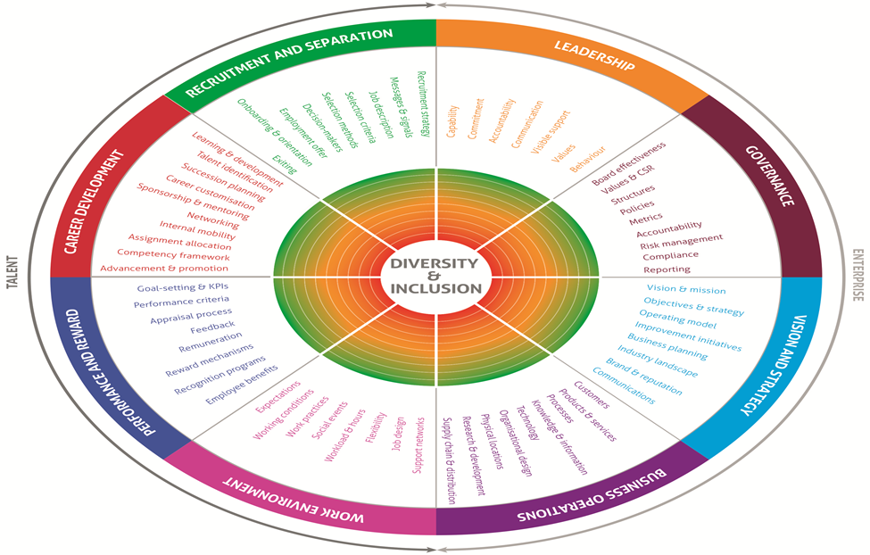
Year 4 – 360 Degree approach
Cohesive and Integrated - Embedding Equality, Diversity &Inclusion into everything we do – 360 degree approach

Slide 7
Year 5 – Speaking up/disruptive inclusion
By Year 5, due to a culmination of activity in the previous years we will have embedded an inclusive culture where listening and learning will be encouraged, innovation hubs will pop up in local teams, where they will be able to demonstrate continuous improvement.
Outcomes
Excelling - Making a difference - Partnership - Communities/Colleagues/Patients working together to deliver one culture of care
Education & Awareness - Challenging others & Championing change becomes the norm. CHFT colleagues role model inclusivity and the Trust is identified externally as an Inclusive Employer by an Independent Organisation
Growth - Grow Innovation & Collaboration within the Trust & with our partners
Diversity of Thought - A balanced workforce that genuinely represents colleague and patients views

Slide 8
Get involved…
Do you want to know more?
You can contact Nikki our Assistant Director of HR at nicola.hosty@cht.nhs.uk

