Slide 1


Your Patient Initiated Follow Up (PIFU) Guide Card for:
Haematology

Slide 2


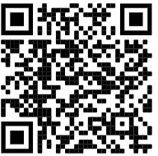
Contact:
If you have developed symptoms which you feel may be related to your haematological condition and you would like to be seen by a clinician; Please contact.
The Appointments centre (01484 355370)
Useful Resources.
https://www.cht.nhs.uk/services/clinical-services/haematology/

