Slide 1


Your Patient Initiated Follow Up (PIFU) Guide Card for:
Coeliac

Slide 2


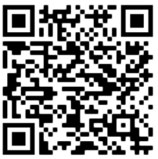
If you experience a flare up of your symptoms or require advice/support before your next appointment please contact;
Who to contact?
Dietetic department Calderdale royal hospital
Telephone: 01422 224267
Email: cah-tr.gastrodietitians@nhs.net
Useful Support resources.
https://www.coeliac.org.uk/home/
CHFT resources can be accessed by the QR code to the right
Or at https://www.cht.nhs.uk/services/clinical-services/nutrition-and-dietetic

