Slide 1
Patellofemoral pain /
Anterior Knee pain
“Pain from the front of the knee”

Slide 2
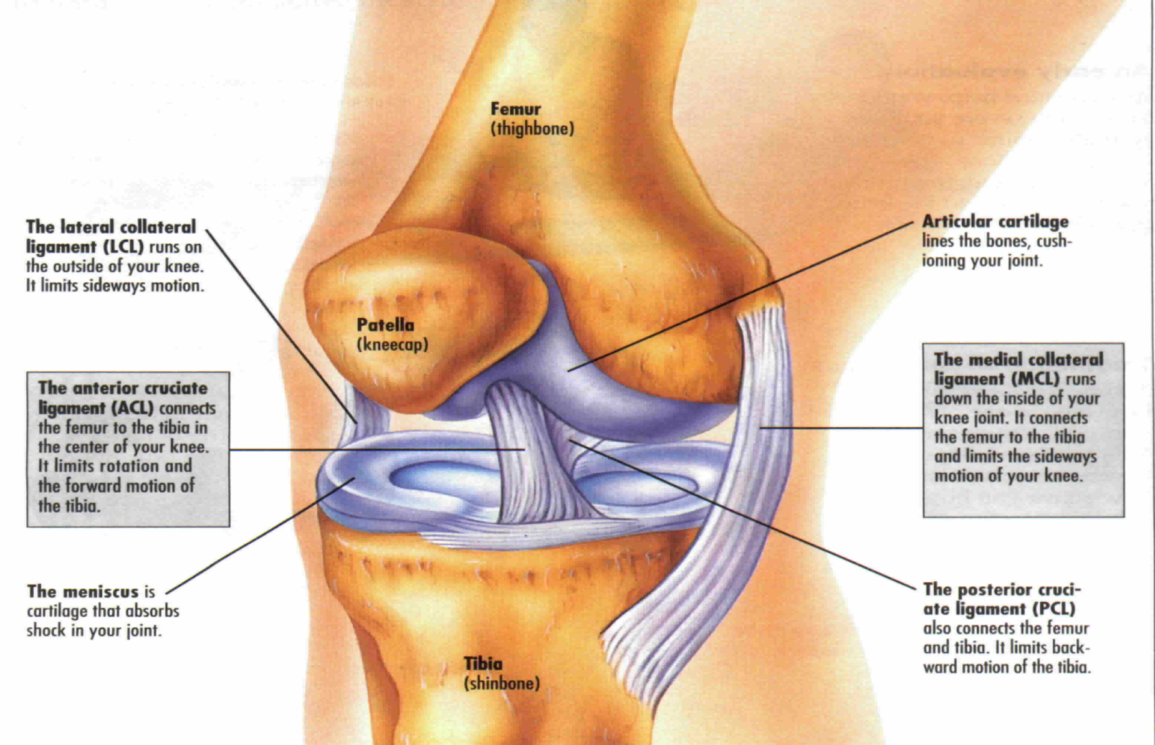
Anatomy of the knee

Slide 3
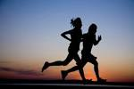
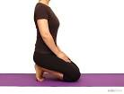


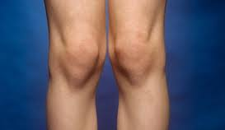
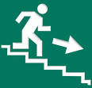
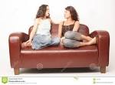
Symptoms of anterior knee pain
pain
catching
Dull ache
Clicking
grinding

Slide 4
Where does my pain come from?
The back of the knee cap is subjected to variable forces as we do activities of daily living.
Activities such as up and down stairs, running or sitting with your knees bent cause increased contact force and pressure between the back of the knee cap and the thigh bone.
Over time the tissue around and behind the knee cap can become irritable and send messages to your brain to give the sensation of pain.

Slide 5
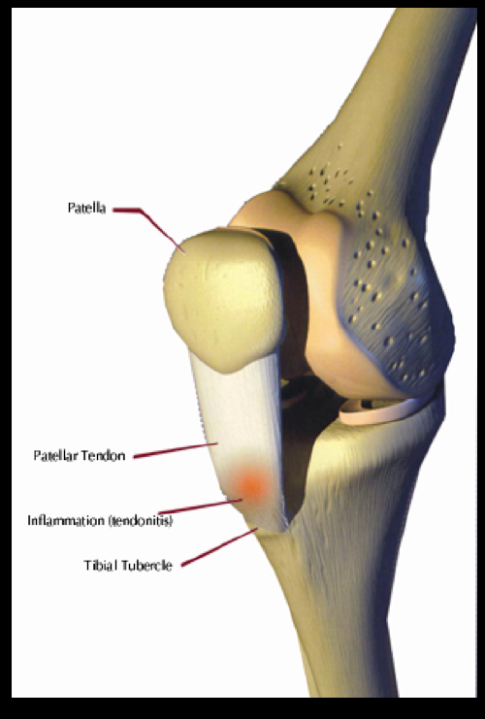
Osgood-Schlatters
Most common causes of knee pain in young people.
Usually occurs during phases of growth.
Bone grows first and the muscle plays catch up.
Where the tendon from the knee cap attaches on the shin bone becomes inflammed and thickened

Slide 6
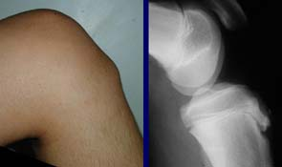
Osgood-schlatters

Slide 7
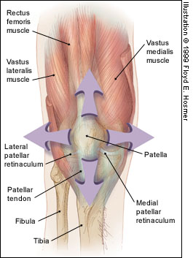
The biomechanics
The knee cap is capable of moving up and down and side to side, but is accompanied with tilting when we move the knee.
This means that the knee cap relies on strong and mobile structures surrounding it to ensure it moves correctly, and not cause pain

Slide 8

Occasionally some structures do not function well
Knee pain
No Knee pain
1. Weak bottom muscles = tilted pelvis
1.Strong bottom muscles = well aligned pelvis
1.
2. Causes Overactive Iliotibial Band
2. Decreases ITB activity = less force on knee cap
2.
3.
3. Weak Quadriceps =
Increased force on knee cap
3.Strong quadriceps = less force on knee cap
4.
4. Overactive Calf = increased force on knee cap
4. Fexible calf = less force on knee cap

Slide 9
How can I make my pain better?
Firstly…. Don’t worry!- your pain can and will improve!!
Exercise – for a number of months regularly
Exercise
Exercise!!!!!!!!!
Adjuncts such as pain killers, heat, ice, taping can help to allow you to exercise!
There is no quick fix!!!!

Slide 10
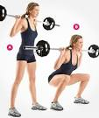
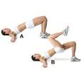

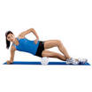
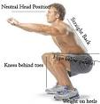
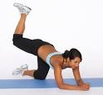


What do I exercise? And how?
Strengthen Gluteals (Bottom Muscles)
Strengthen Quadriceps (Thigh muscles)
Mobilise and desensitise Iliotibial band (outer thigh)
Mobilise and desensitise gastrocnemius(Calf)

Slide 11
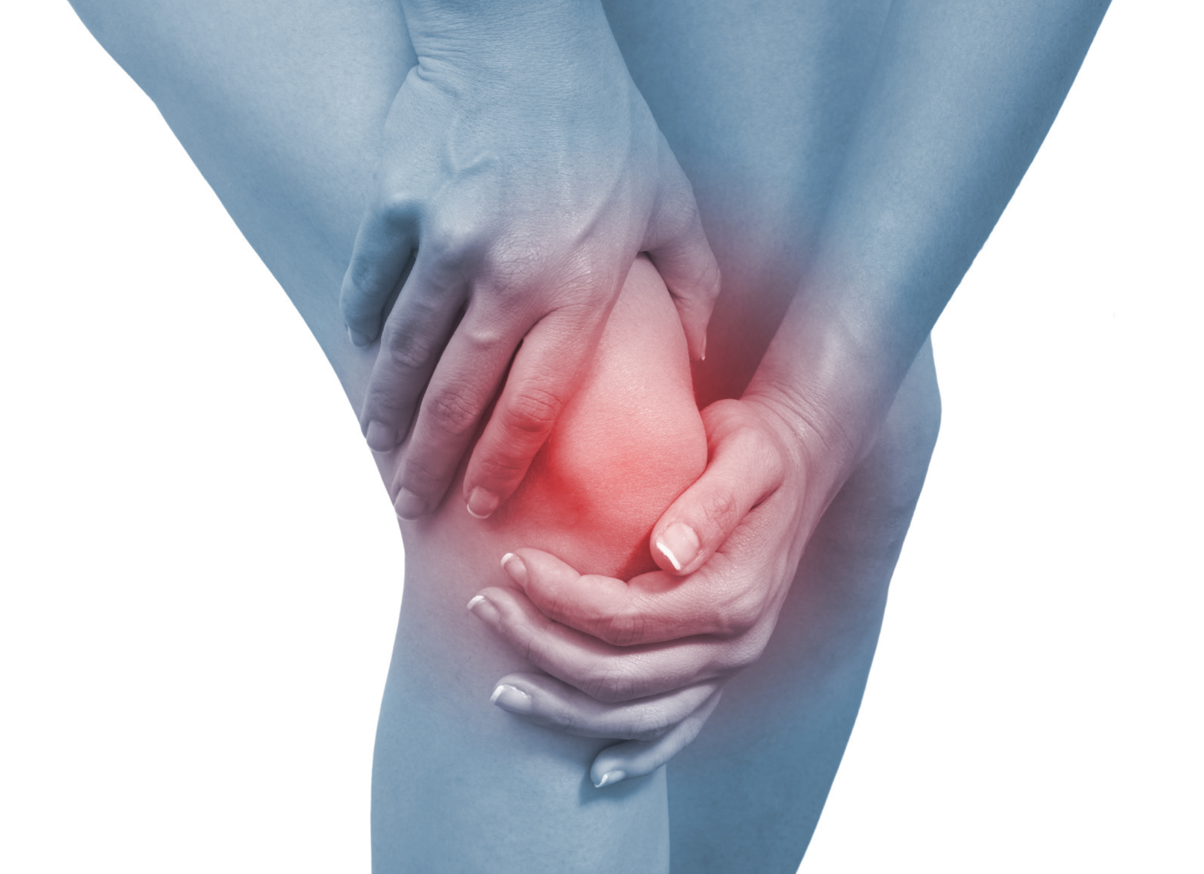
Lets Get going!!!!
Foam roller
Gluteal work out
Stretch
Gluteal workout
Basic Quadriceps
Standing gluteals
Functional work
Foam roller and stretch

