Slide 1
Health Care Worker COVID-19 Contact and Isolation Pathway
Version 4 01/04/22
Updated 4th April to letter “Living with Covid-19 –testing update” 30.3.2022 NHSe and NHSi, and “Managing healthcare staff with symptoms of a respiratory infection or positive COVID-19 test result” 1.4.2022
Contents
Action Card 1 –symptomatic staff member
Action Card 2 –contact of confirmed/suspected case
Visual of isolation and LFT test requirements depending on date and results
Useful links and contacts
Symptoms of COVID-19, flu and common respiratory infections.

Slide 2
Scenario 1 Staff Member with respiratory symptoms
Action Card 1 Staff member rings up line manager symptomatic of respiratory symptoms or develops symptoms whilst at work.
Stay at home or immediately go home from work and avoid contact with other people
Undertake a lateral flow test (Covid-19) – report result on Govt website and send copy of email / text response to manager
Negative LFT | Positive COVID-19 test result (no requirement for confirmatory PCR where positive LFT reported)
Return to work, if they feel well enough and do not have a fever. | Do not attend work after a positive COVID-19 result for 5 days, counting date of onset of symptoms (or date of test if no symptoms) as day zero.
Staff member to complete self declaration document for symptoms | Manager to contact trace for staff/patient exposures where staff member working in the 48hrs prior to onset of symptoms.
Manager to complete risk assessment document. | Patient facing healthcare workers to START performing daily lateral flow tests (LFT) starting from day five provided they had no fever for at least 48hrs. “Return to work” criteria is TWO SUCCESSIVE negative lateral flow tests, taken 24hrs apart.
 | Colleagues with no patient contacts may return to work after 5 days if well, and do not have a fever.
Continue with twice weekly LFD test starting 48 hours after the onset of symptoms | Frontline HCW -Negative LFT See illustration on page 4 | Frontline HCW Positive LFT See illustration on page 4
Rigorously follow the IPC precautions and PPE guidance already in place. | Return to work on day six (or on second neg LFD Test), provided pre shift LFT remains negative and no fever present. | Remain at home and continue to test every 24 hours up to day 10 after symptoms started.
 | Manager to complete risk assessment. Continue with twice weekly LFD. Remain rigorous with IPC precautions | If LFD pos at day 10, Manager to complete risk assessment for return to work. Continue with twice weekly LFD tests. Remain rigorous with IPC precautions

Slide 3
Scenario 2 Asymptomatic staff member with COVID Contact
Action Card 2- People who live in the same household as someone with COVID-19 are at the highest risk of becoming infected because they have prolonged close contact. People who stay overnight in the household of someone with COVID-19 are also at higher risk. It can take up to 10 days for infection to develop. It is possible to pass on COVID-19 to others, even if you have no symptoms.
Staff member must inform their manager if they have been a close contact of someone with confirmed COVID-19.
Patient-facing staff member with close contact to continue with twice weekly LFT testing
Staff Member remains rigorous with IPC precautions and remains vigilant for the development of symptoms and complete the daily self declaration (arrange covid-19 test if symptomatic)
If symptoms develop follow action card scenario 1
Manager to complete risk assessment document.
Consider deployment to areas or a role where there is lower risk of impact of transmission to others.
HIGH RISK AREAS - Ward 12 (HRI) Macmillan & Greenlea and NICU units, Lateral flow tests (LFT) to be completed daily for 10 days prior to the start of each shift, reported into the National system and proof send to line manager.
Return to work may then proceed with the following risk mitigations in place for 10 days from date of last contact. They must not have fever. Proof of completed LFT on the day, where applicable. PPE to worn at all times (IIR surgical face mask minimum. If FFP3 required must be NON-VALVED) Must maintain 2 metre social distancing where possible. No breaks to be taken with other colleagues.

Slide 4
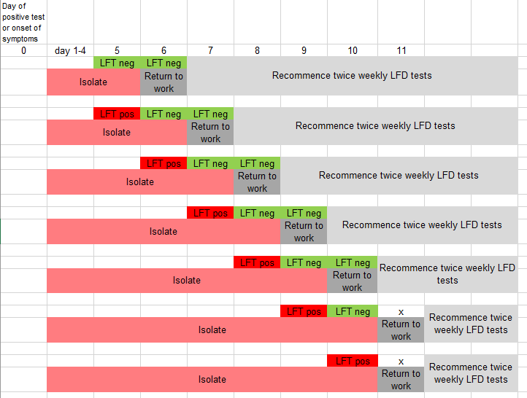
Isolation and LFT test requirements for patient facing healthcare colleagues.

Slide 5
Useful links and contact details
FORMS: Manager Risk Assessment Form
Ordering Lateral Flow Tests
Orders should now be placed via the online portal at https://www.gov.uk/order-coronavirus-rapid-lateral-flow-tests
Occupational Health - 01484 34 4280 or by email on occupational.healthCHT@cht.nhs.uk
Microbiologist - On call through hospital switchboard.
Infection Control - On call through hospital switchboard.
Clinical Commander - HRI 07584387144 CRH 01422 223421
Testing team – HRI: 01484 34 5518 CRH: 01422 22 4029
Matron - On call through hospital switchboard.
Government guidance
https://www.gov.uk/government/publications/covid-19-management-of-exposed-healthcare-workers-and-patients-in-hospital-settings/covid-19-management-of-exposed-healthcare-workers-and-patients-in-hospital-settings
https://www.gov.uk/government/publications/covid-19-guidance-for-people-whose-immune-system-means-they-are-at-higher-risk

Slide 6
Symptoms of Covid-19, Flu and common respiratory infection
Continuous cough
High temperature, fever, chills
Loss of, or change in your normal sense of taste or smell
Shortness of breath
Unexplained tiredness, lack of energy
Muscle aches or pains that are not due to exercise
Not wanting to eat or not feeling hungry
Headache that is unusual or lasts longer than usual
Sore throat, stuffy or runny nose
Diarrhoea, feeling sick, being sick.

